Slide 1
Quasi-Experiments & Small-N Designs

Slide 2

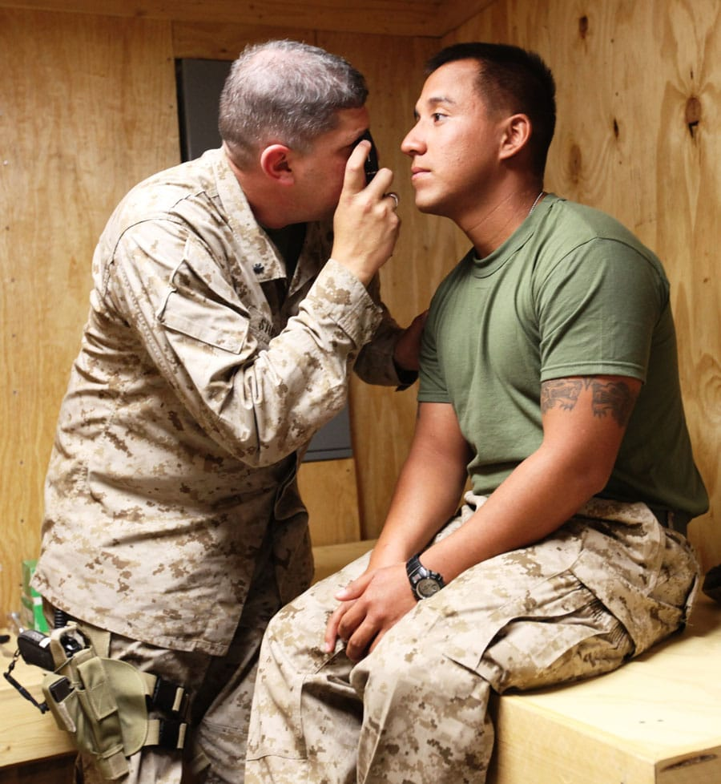
Why Quasi-Experiments?
Quasi-Experiments allow us to…
Capitalize upon naturally-occurring events or situations
Avoid ethical problems
BUT…
The researcher has no control over the independent variable
(which is why it’s called a quasi-independent variable)

Slide 3
Terminology
1
3
2
Quasi
N
“resembling”
Population size
Nonequivalent Control Groups
Two or more groups of participants that didn’t use random assignment

Slide 4
The Four Types of Quasi-Experiments
Nonequivalent control group posttest-only design
Interrupted time-series design
Independent-Groups Designs
Within-Groups Designs
Nonequivalent control group pretest/posttest design
Nonequivalent control group interrupted time-series design

Slide 5
Nonequivalent Control Group Posttest-Only Design
Group 1
Exposed to treatment/intervention
(no random assignment)
Posttest
Two groups are compared on DV
Group 2
NOT exposed to treatment/intervention
(no random assignment)

Slide 6
Nonequivalent Control Group Pretest/Posttest Design
Group 1
Exposed to treatment/intervention
(no random assignment)
Pretest
Two groups are compared on DV before
Posttest
Two groups are compared on DV after
Group 2
NOT exposed to treatment/intervention
(no random assignment)

Slide 7
Interrupted Time-Series Design
One Group
INTERRUPTION
(no random assignment)
Collect lots of data during interruption
January
February
March
April
Collect lots of data for a while before interruption
Collect lots of data for a while after interruption

Slide 8
Nonequivalent Control Group Interrupted Time-Series Design
INTERRUPTION
Group 1
(no random assignment)
January
February
March
April
Group 2
(no random assignment)
January
February
March
April

Slide 9
?
Your Turn

Slide 10
2
Small-N Designs
Studying only a few individuals

Slide 11
Small-N Designs
Multiple-Baseline
Researchers stagger their introduction of an intervention across a variety of contexts, times, or situations
Stable-Baseline
Researcher observes behavior for extended baseline period before beginning a treatment or other intervention, and continues observing behavior after the intervention
Reversal
Researcher observes a problem behavior both before and during treatment, and then discontinues the treatment for a while to see if the problem behavior returns

Slide 12
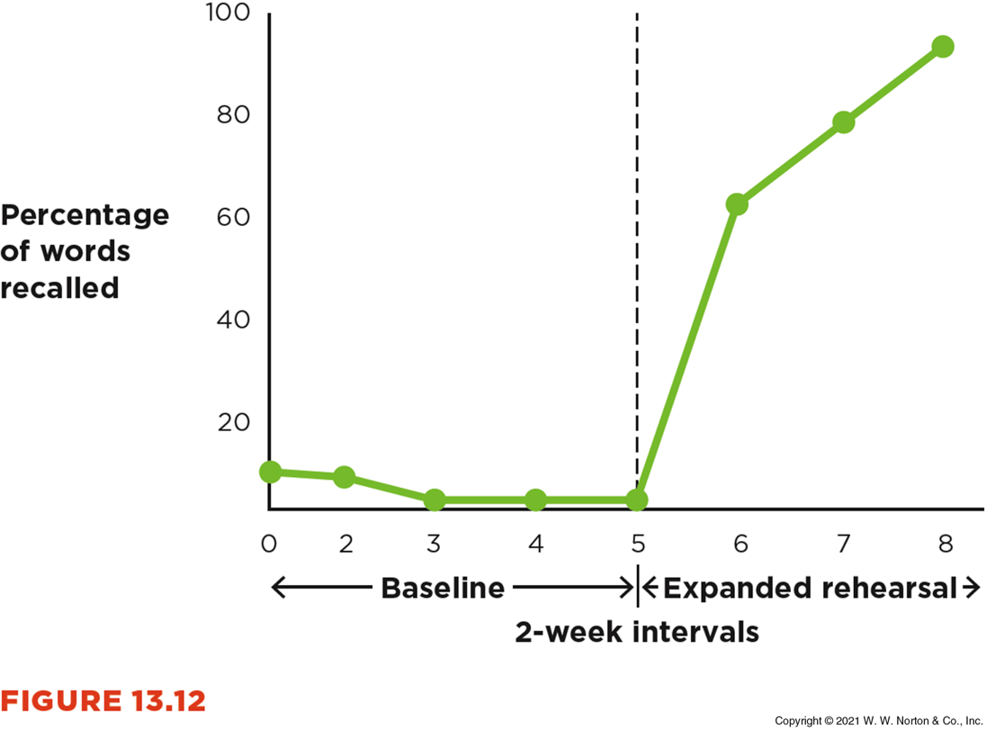
Stable-Baseline Design

Slide 13
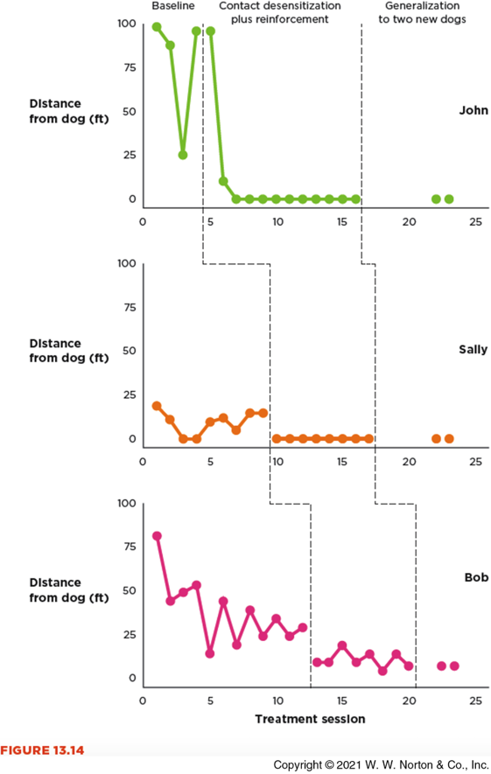
Multiple-Baseline Design

Slide 14
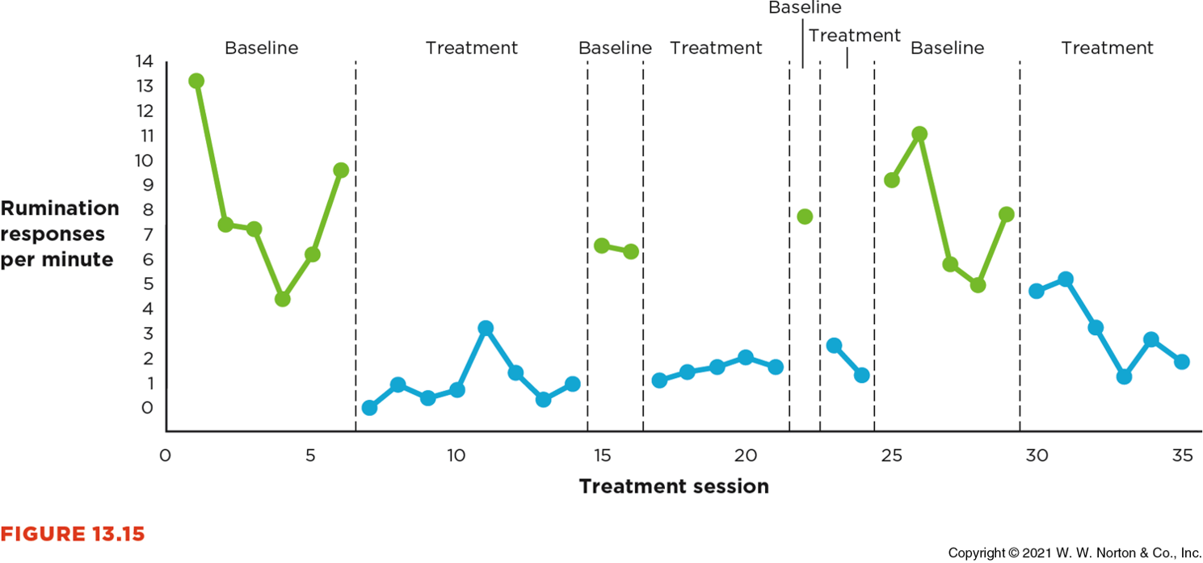
Reversal Design

Slide 15
Suppose you’re a dog owner and are working with your 3-year-old Labrador retriever. When the dog goes for walks, he growls fiercely at other dogs. You want to reduce your dog’s growling behavior, so you decide to try a technique you learned on television: pressing firmly on the dog’s neck and making a forceful, quick “Shhhhh!” sound when the dog begins to growl at other dogs. You decide to apply a small-N design to investigate the effectiveness of your training regimen.
Practice!

Slide 16
a. Which small-N design(s) would be appropriate for this situation? b. Choose one small-N design, and describe how you would conduct your study. c. Sketch a graph of the results you would predict from your design if your treatment worked. d. Explain whether you could conclude from your study’s results that the treatment caused your dog’s aggressive behavior to decrease.

Slide 17
Before we go…
Write down:
1. One thing you understand really well after today’s class.
2. One thing that’s still muddy for you.

